Slide 1


Helping Hands
Department of Computer Science and Engineering
(Supervisor: Mr. Rohit Chaudhary)
Name of Member | Roll No | Branch
Shivam Kumar | 2001330109026 | CSE
Mayank Gupta | 2001330109010 | CSE
Himanshu | 2001330109008 | CSE
Nishant Chaudhary | 1901330100179 | CSE

Slide 2
INDEX
Introduction
Project Objective
Technology
Snapshot
Future Scope
Conclusion
References

Slide 3
INTRODUCTION
In this Project we are provide some features like Furniture, Salon, Cleaning and Pest Control, Appliance Repairs and Laundry.
Depending on the nature of your Equipment's Problem, Your site Service Call can be Completed the same day. Our Technicians Provide Expert Service on all Makes and models of washing Machine, Air conditioner, Refrigerator, Microwave oven and LCD LED TV.
We Use State-Of-The-Art Front Loading Washing Machines And Premium Detergents For Wash Fold And Laundry Services To Give Your Clothes That Special Care It Needs.
For All Furniture Repair Services Such As, Visitor Chair Repairing And Service Work, Office Furniture Repair Service, Home Furniture Repair Services.

Slide 4
The Best And Most Trusted Portals For Booking For Pest Control, Cleaning, Sanitization And Disinfecting Services In India. Through This Portal, One Can Hire The Best Quality Services At Reasonable Cost.
Salons Is One Of The Leading Providers Of Event Technology Solutions For Online And Onsite Registration, Data Tracking And Capture, For The Exhibition And Events Industry.

Slide 5
PROJECT OBJECTIVE
To understand the customer expectation and satisfaction from Helping Hand (beauty services).
Helping Hand marketplace that helps connect service providers with service seekers. This is an end to your everyday problems. If you are searching for a beautician, a plumber, a mechanic, a cleaner, or a Salon, Helping Hand is studded with hailing professionals in all. Helping Hand, fuelled with the intention of changing the way local servicemen are working and paid.

Slide 6
TECHNOLOGY
Php
Android
Java

Slide 7
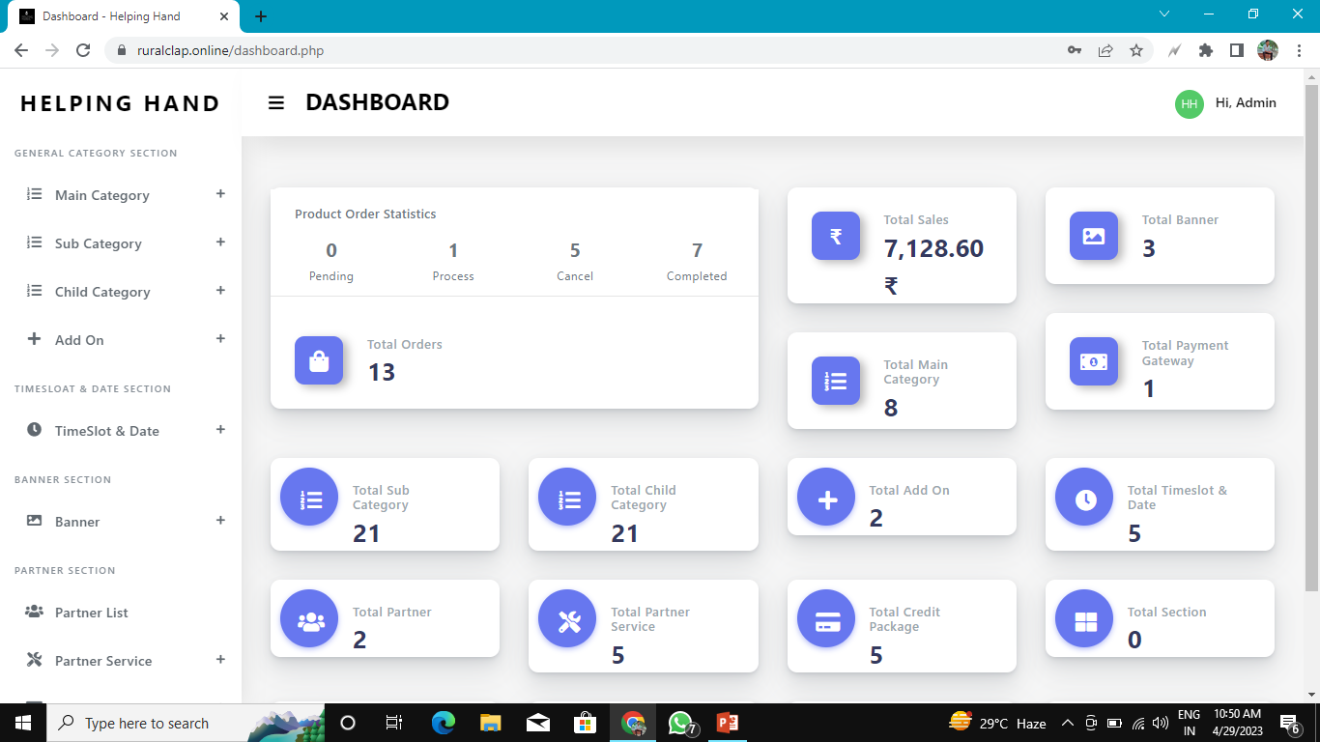
DashBoard

Slide 8
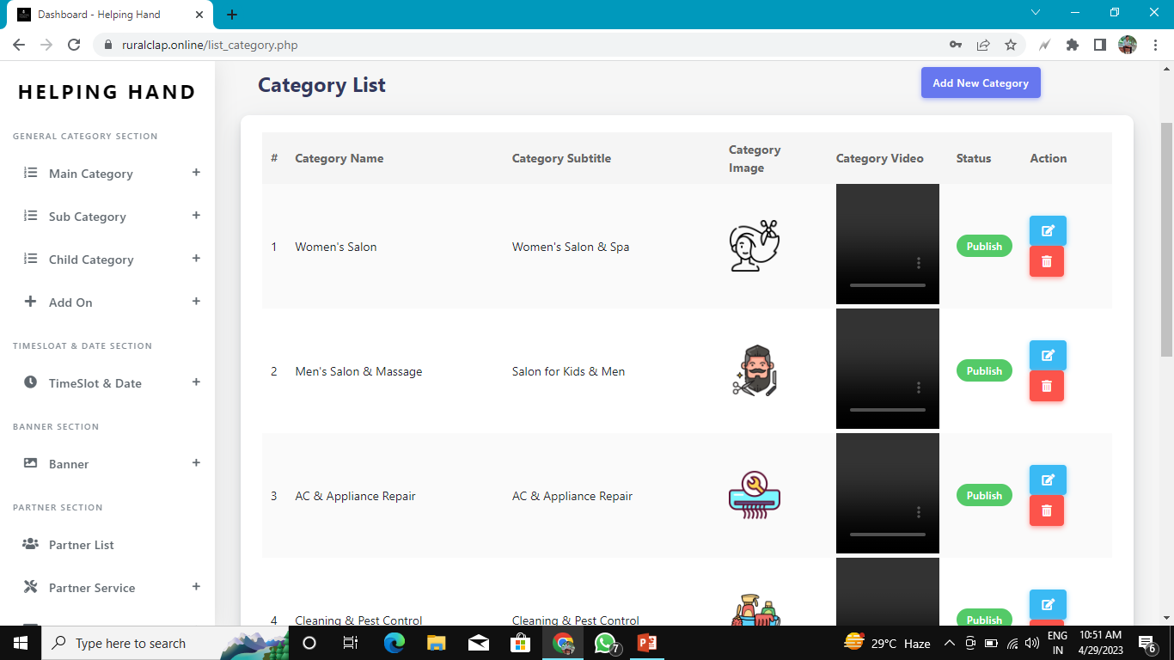
Category

Slide 9
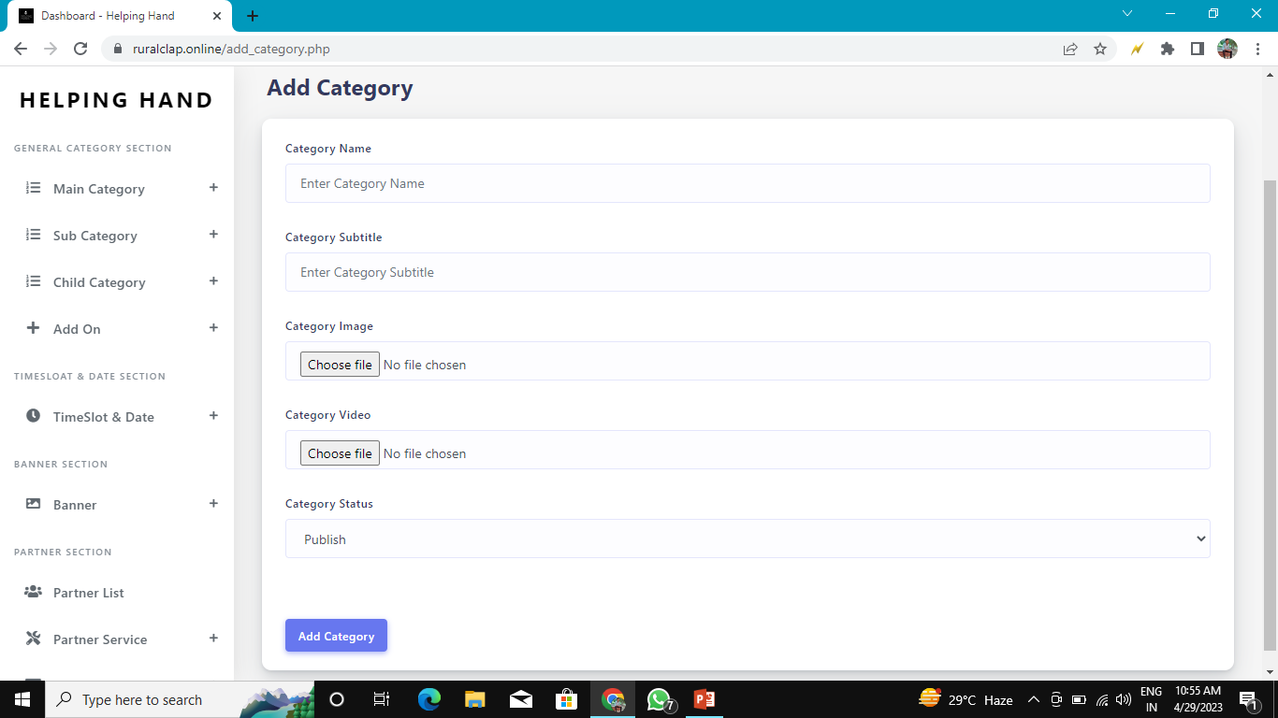

Slide 10
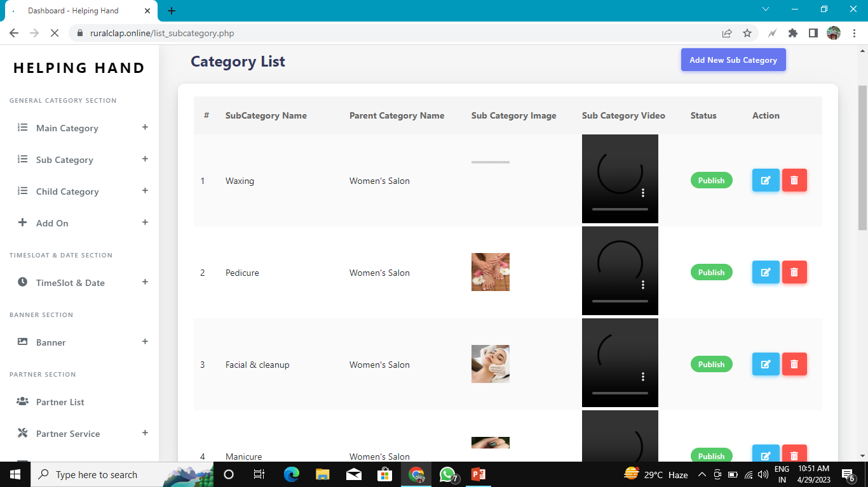
Sub Category List

Slide 11
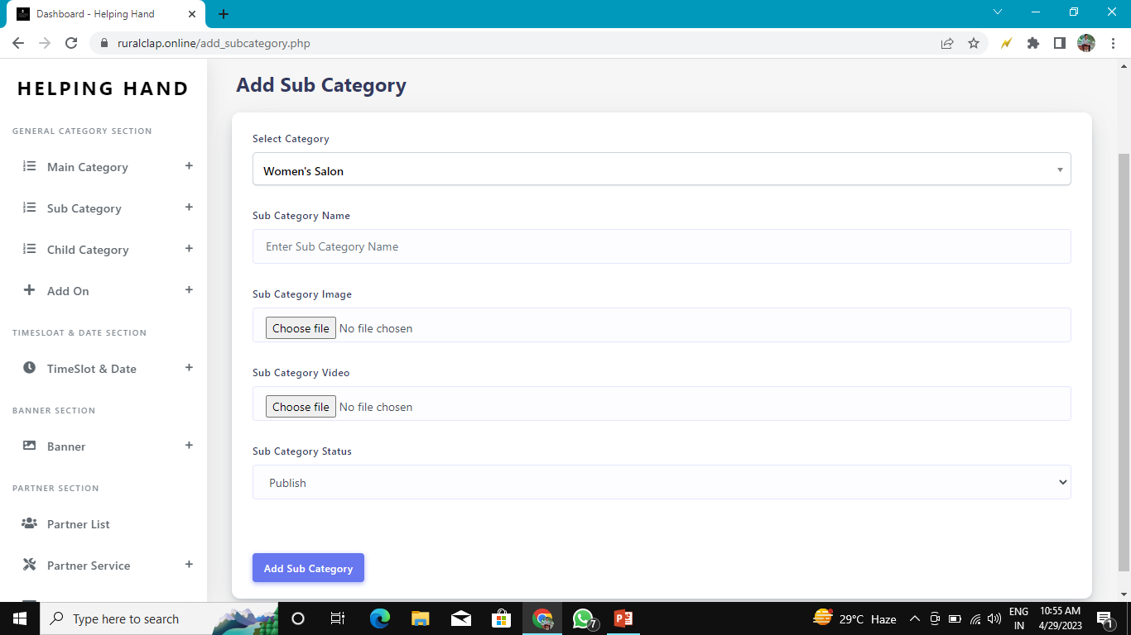

Slide 12
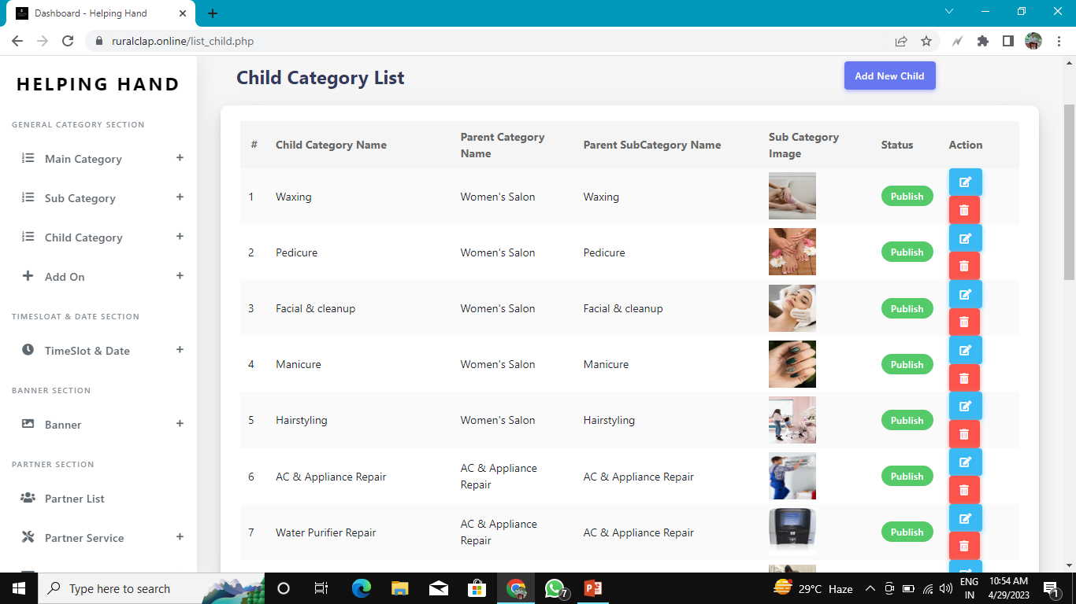
Child Category

Slide 13
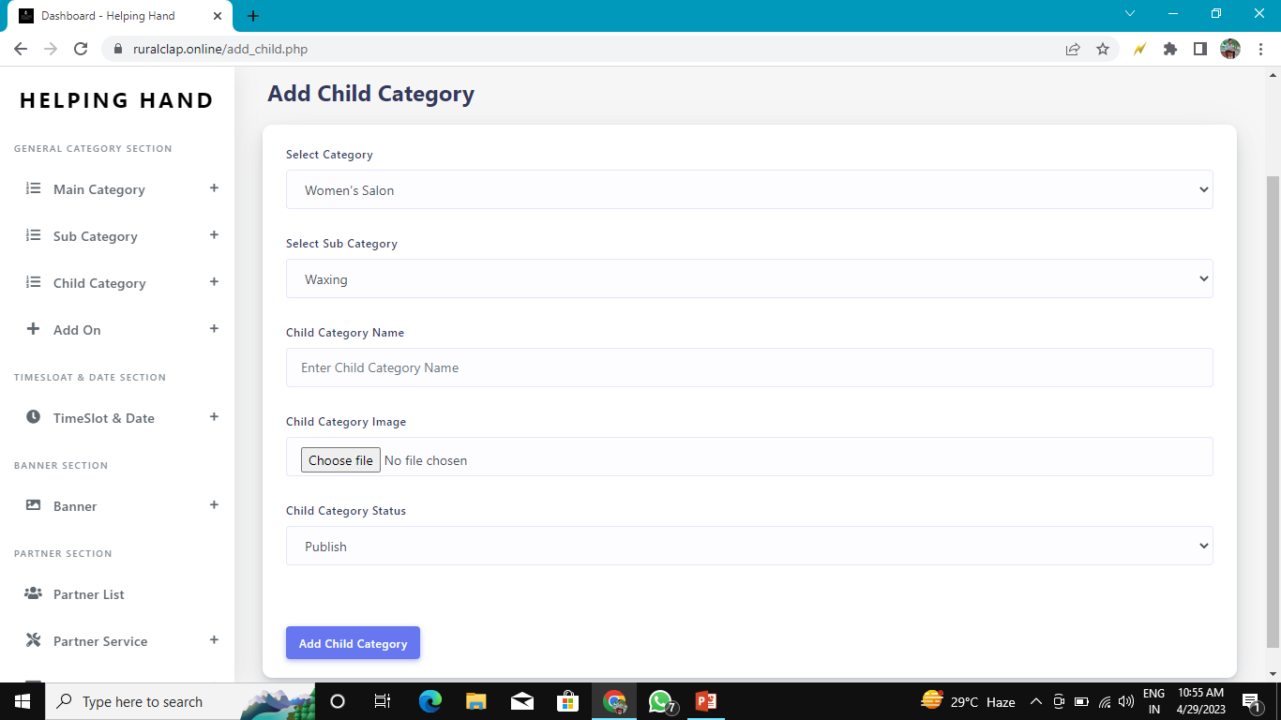

Slide 14
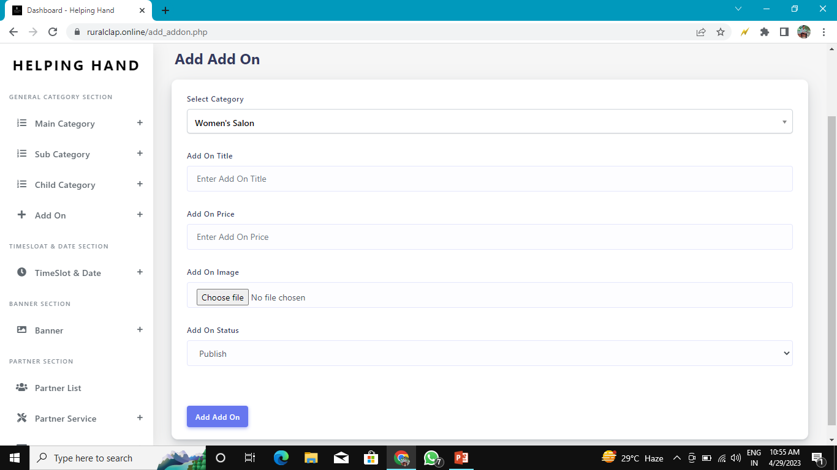

Slide 15
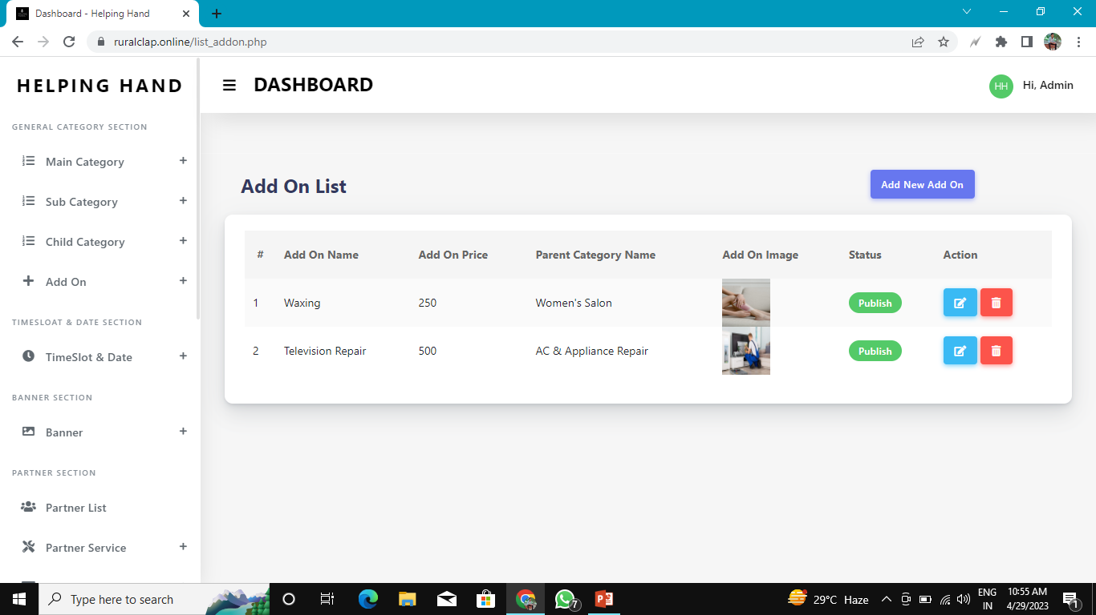

Slide 16
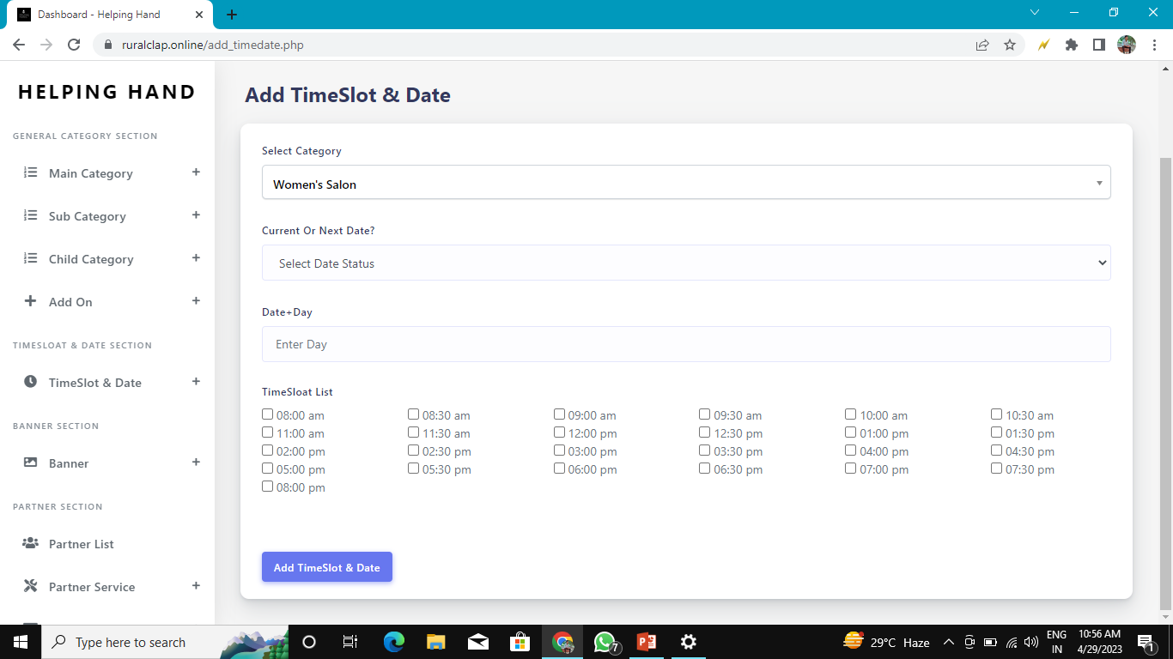

Slide 17
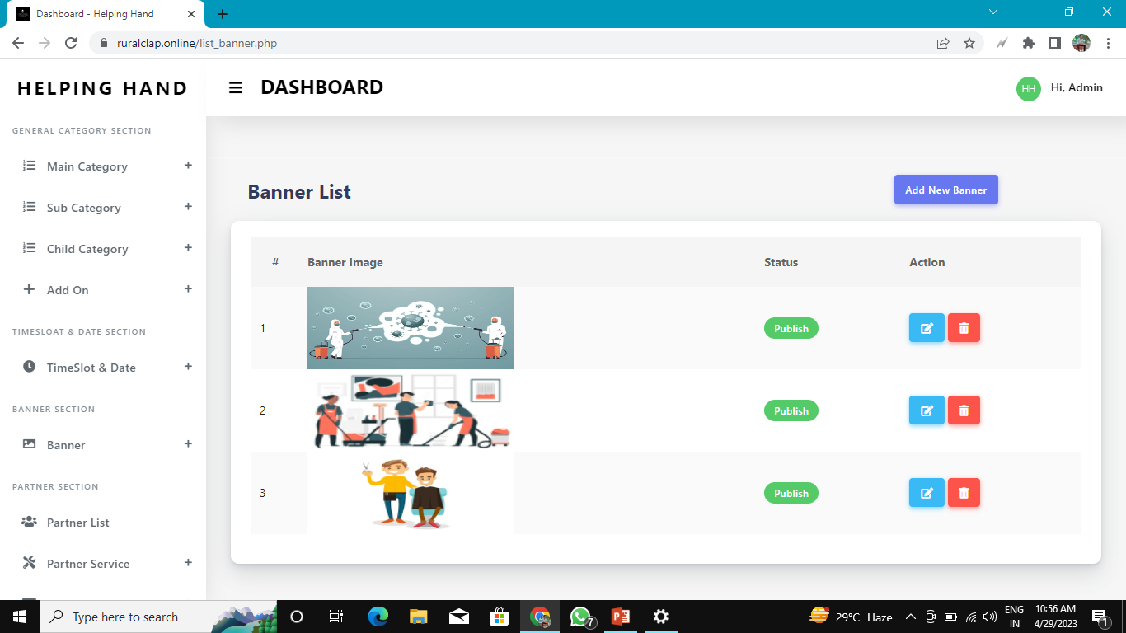
Banner List

Slide 18
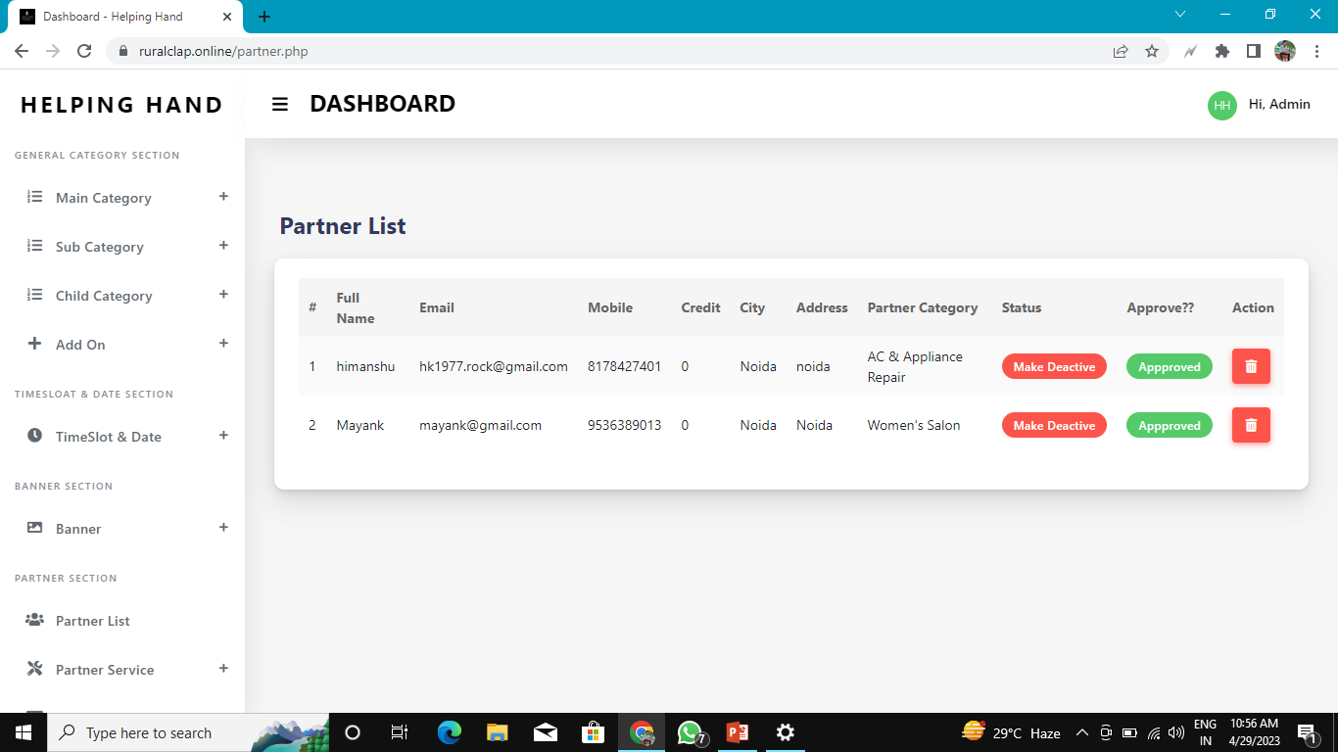
Partner List

Slide 19
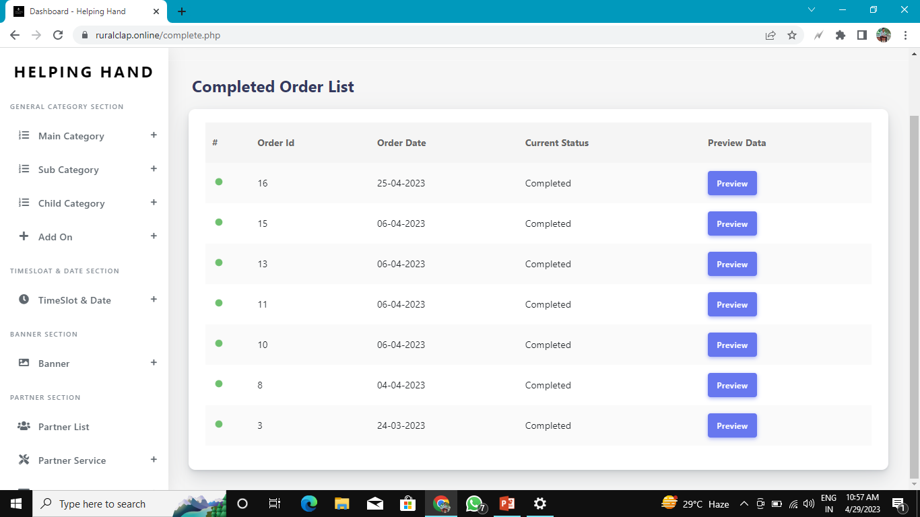
Order List

Slide 20
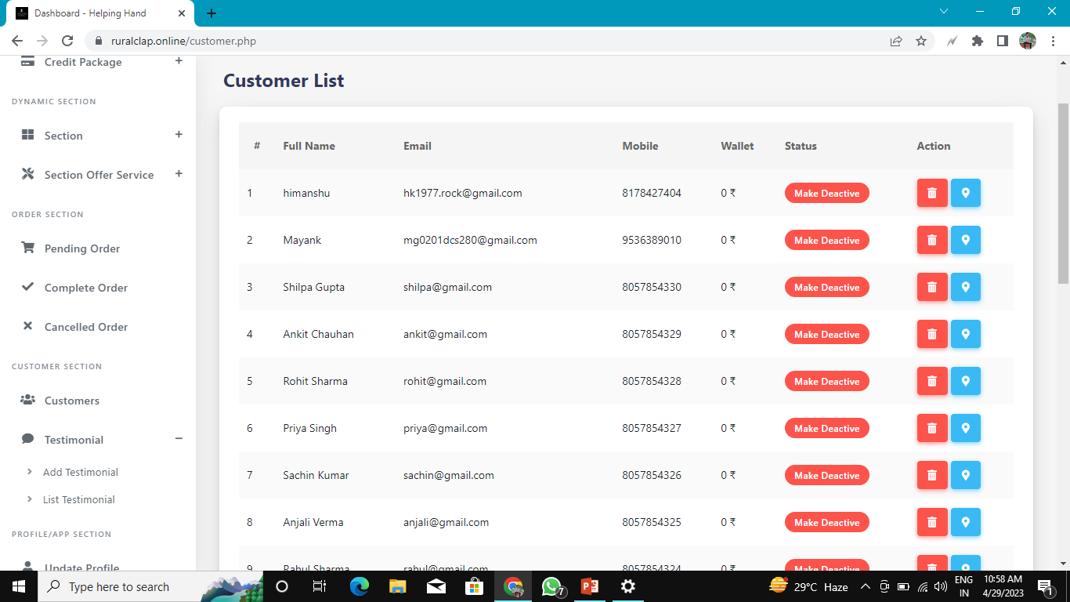
Customer List

Slide 21
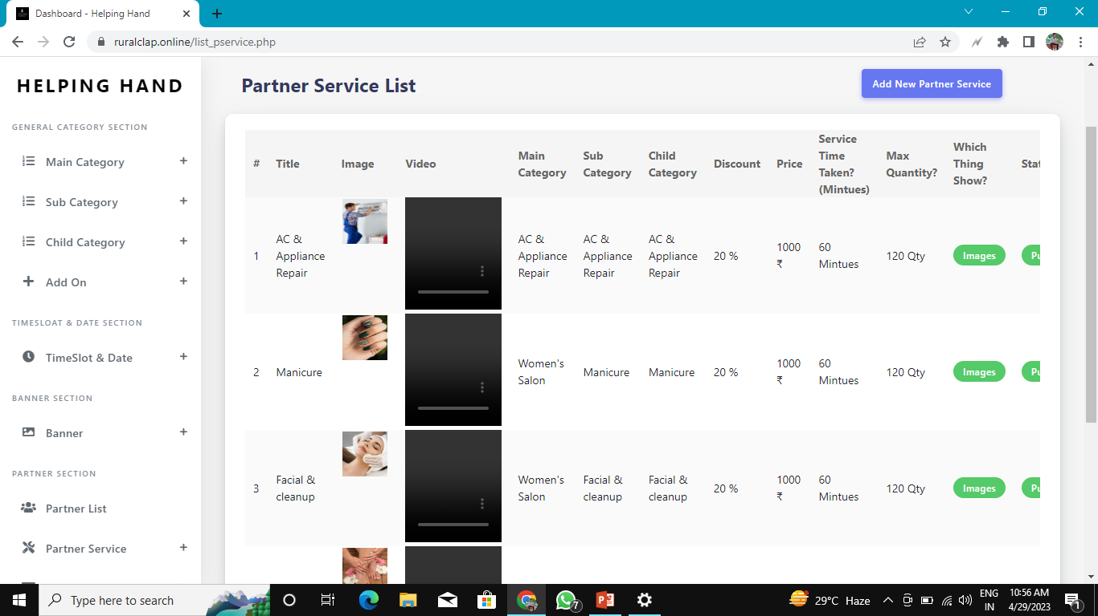
Partner Service List

Slide 22

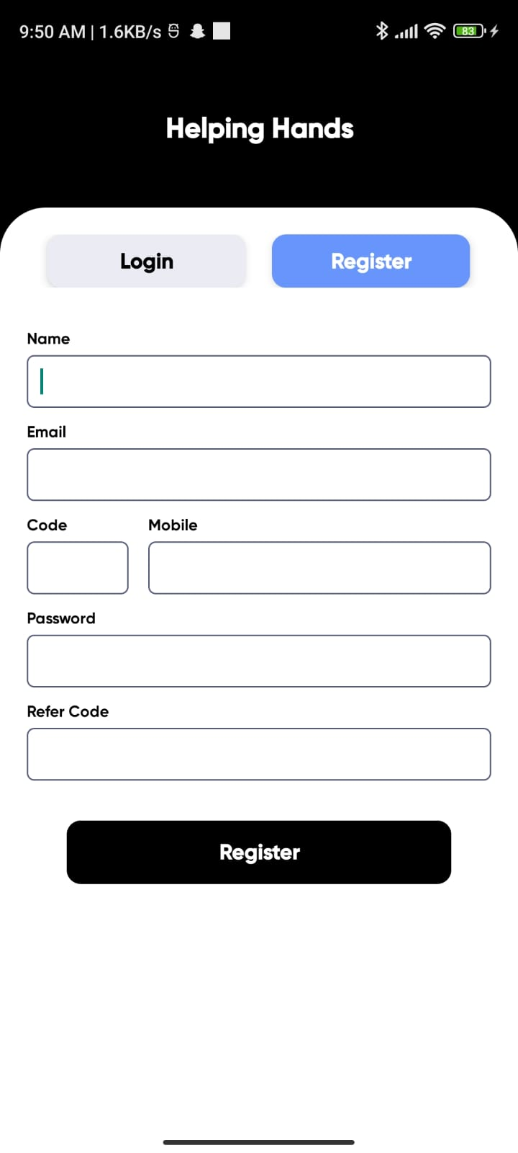
Helping Hand Apk

Slide 23
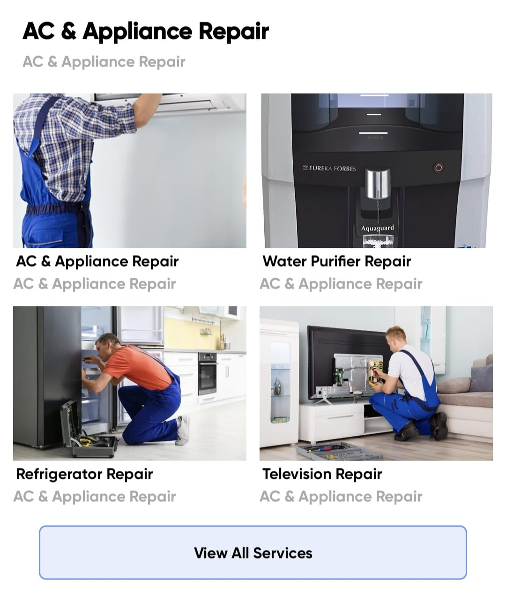
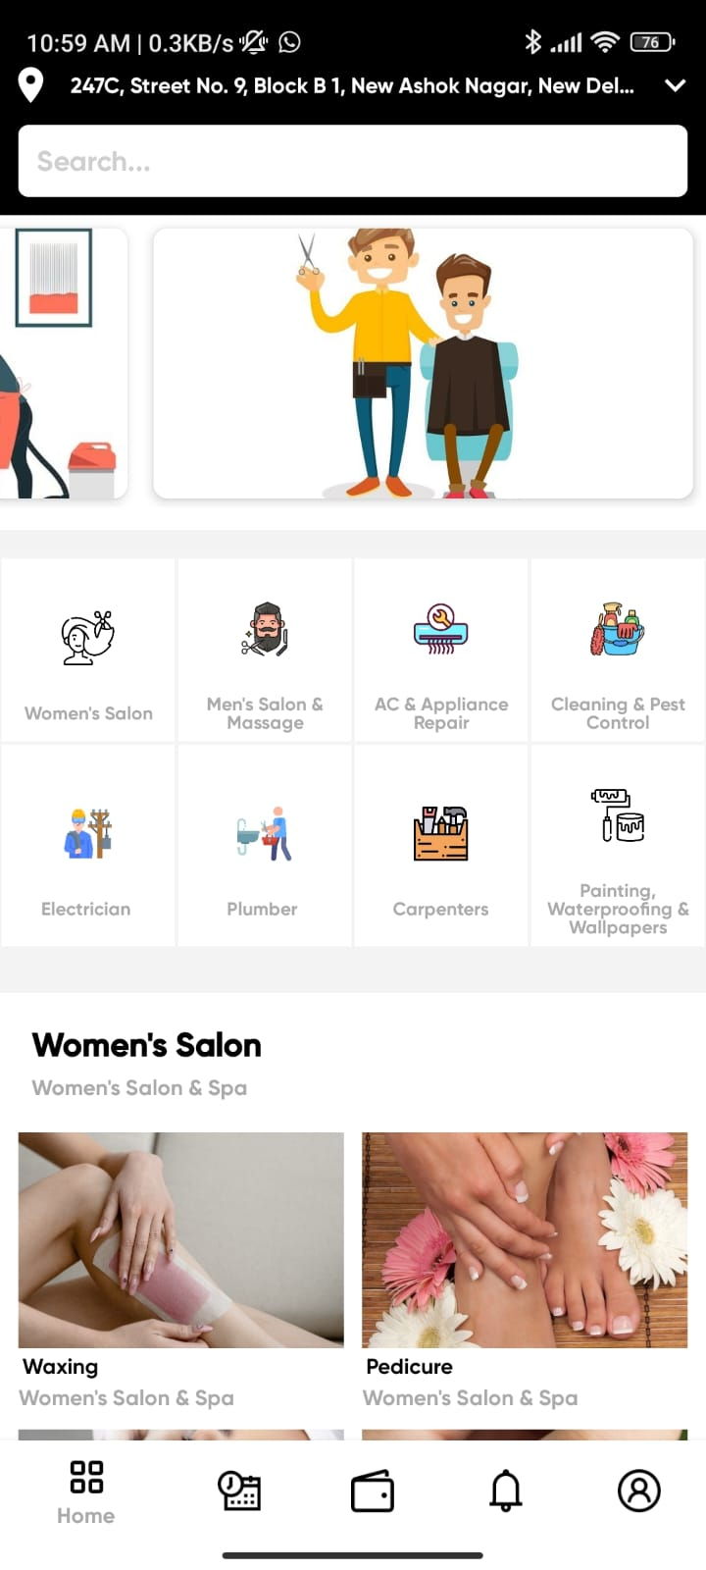

Slide 24

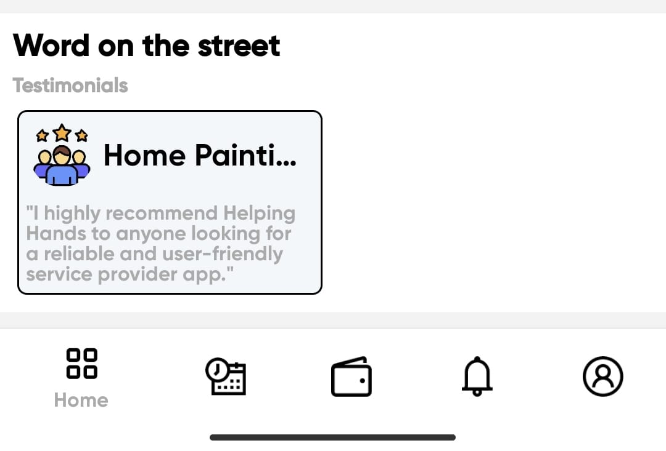

Slide 25
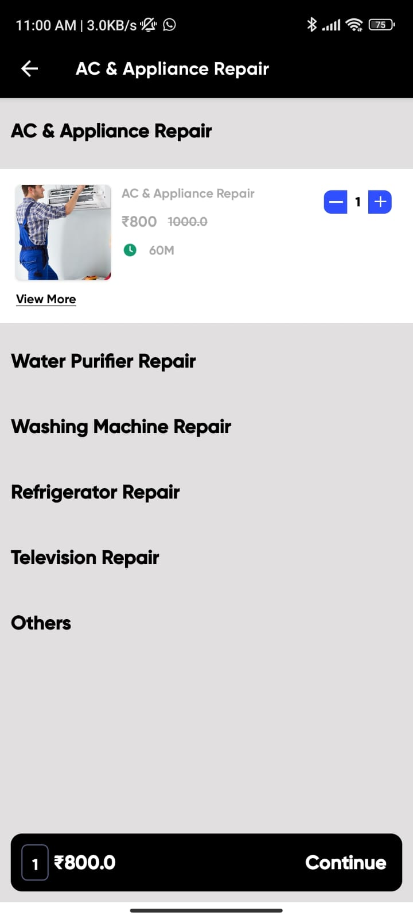
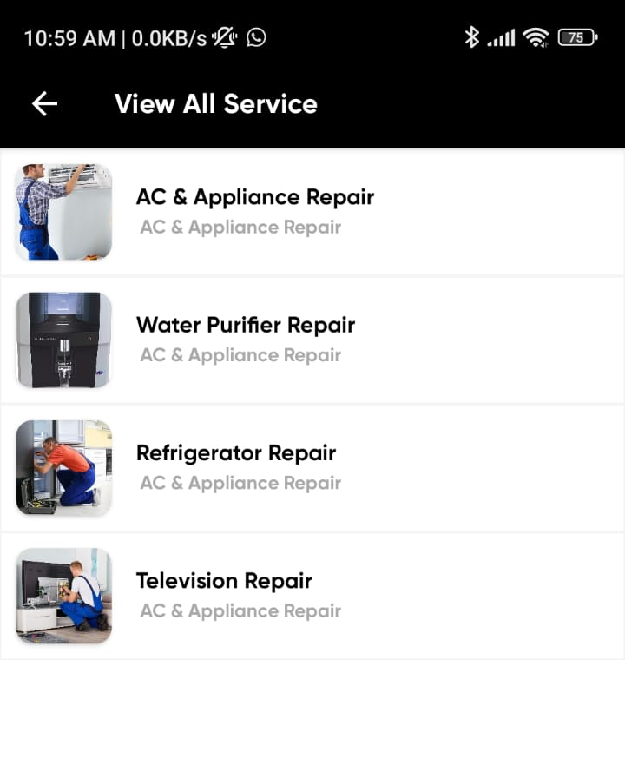
Booking Service

Slide 26
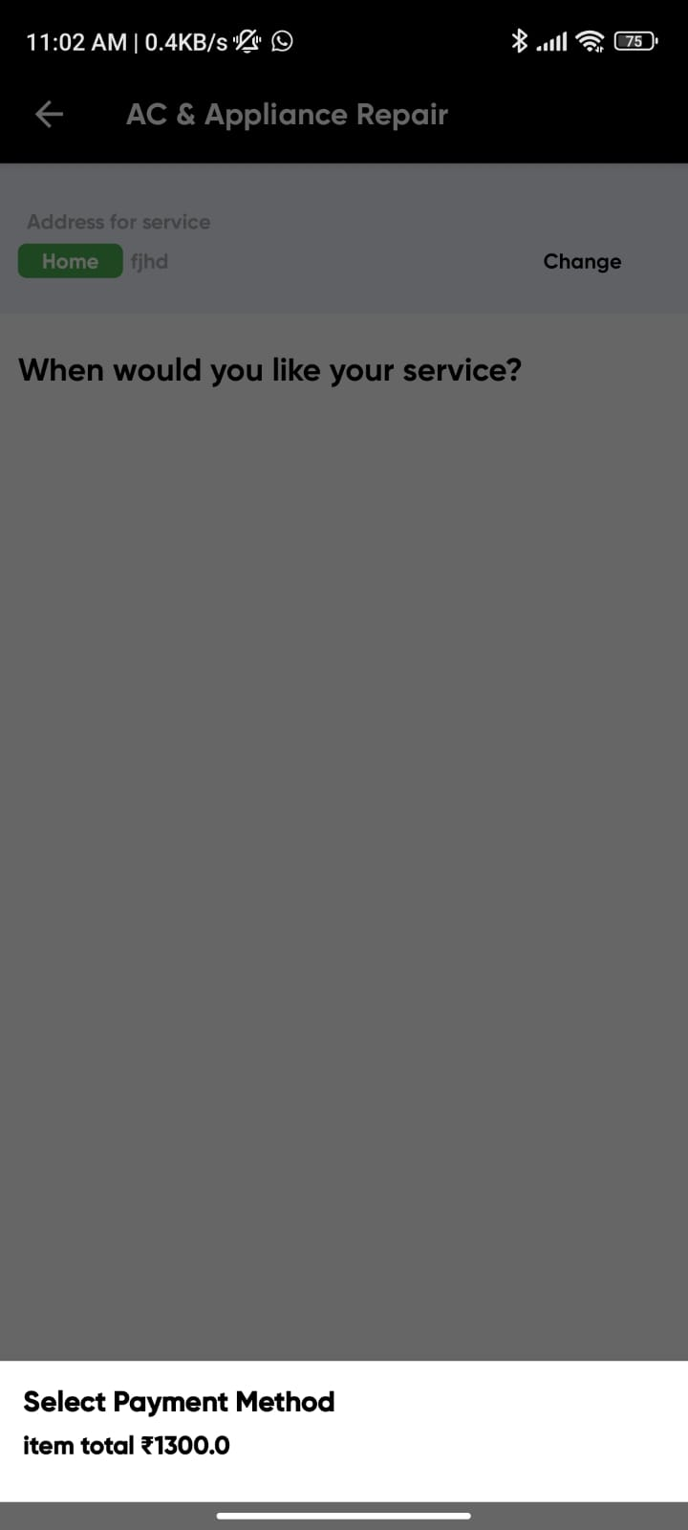
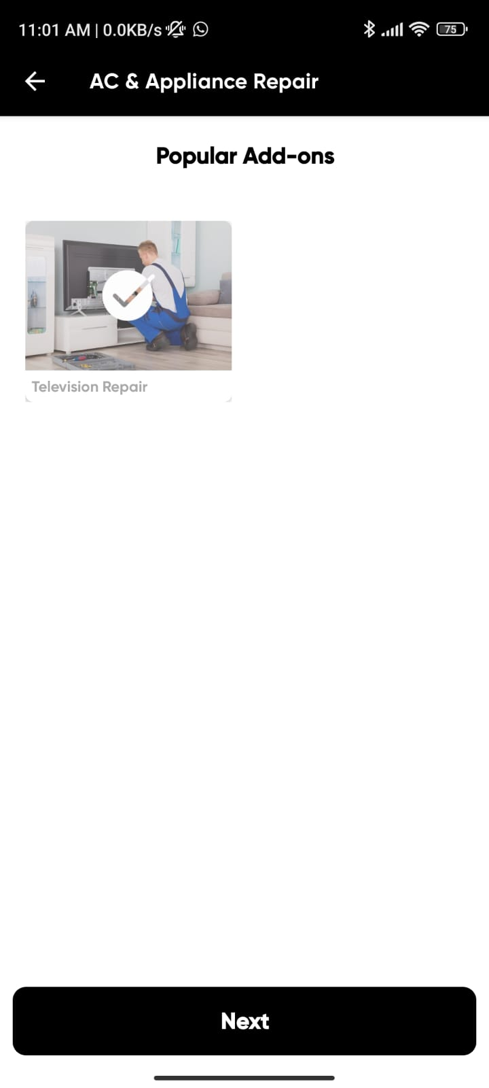
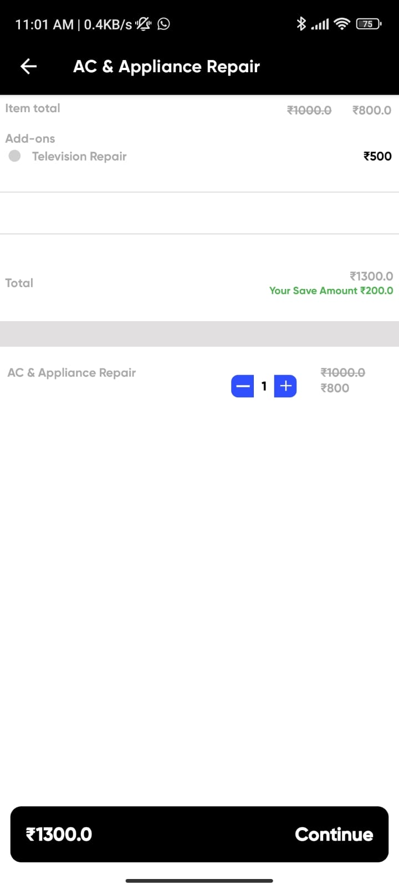

Slide 27
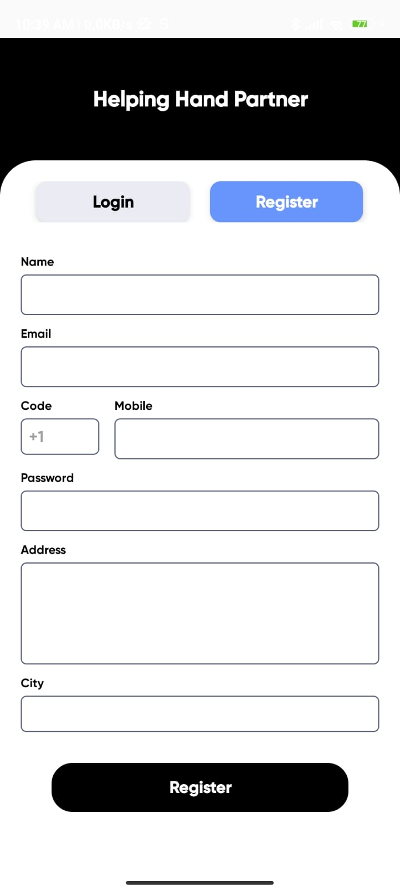
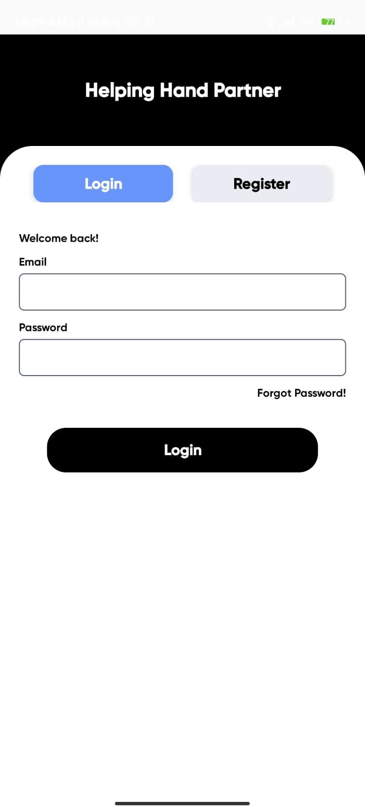
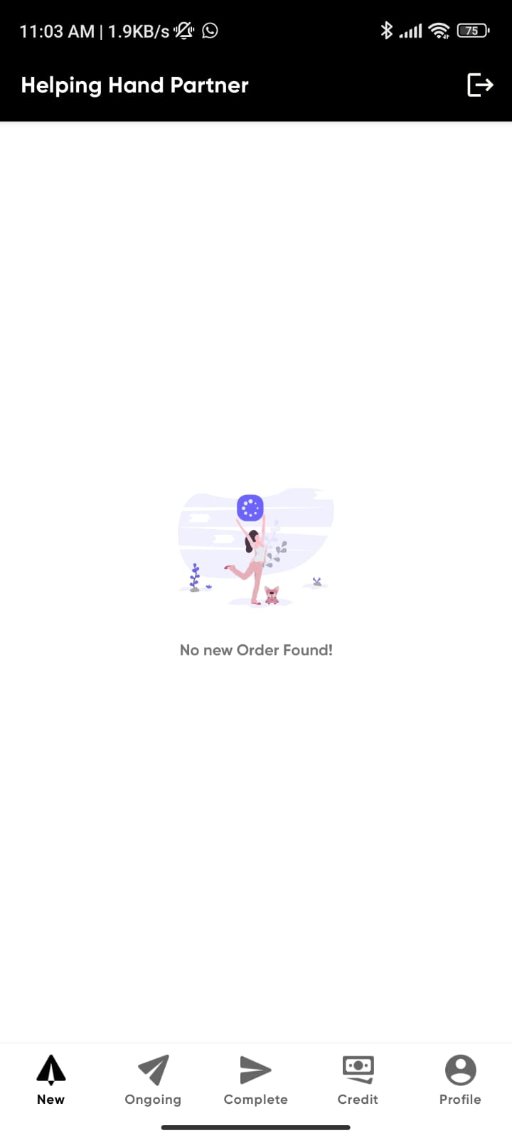
Helping Hand Partner

Slide 28
FUTURE SCOPE
The company should focus that downloading the Helping Hand app should be very easy & customer should not have any problem to book the services from the Helping Hand app.
After the survey it was also found that the service provider should reach on time to provide services which will make the customer delight .
The Helping Hand kit which the service providers use should be having all the accessories required to give customised service to customer.
The hygiene level of the service provider is also very important for the customer; the service provider should be hygiene & should be very professional in the terms of services.
Helping Hand is now planning to add beauty products to its at-home service business model. Helping Hand is considering selling quality products to its customer to augment its beauty segment.

Slide 29
CONCLUSION
As on the basis of above data analysis it has been proven that there is a significant relationship between customer’s expectations and satisfaction with the provided beauty services. As per the survey, it is found that more people respondents are satisfied with the Helping Hand services. However to improve more and give better services to their customer, Helping Hand can focus on few points such as..
The company should focus that downloading the Helping Hand app should be very easy & customer should not have any problem to book the services from the Helping Hand app.
The Helping Hand representative should have the complete & proper information about the services and products which he/she is giving to customer.
The company should take proper feedback from customer after providing services which also shows professionalism.

Slide 30
REFERENCES
Urban Company

Slide 31
THANK YOU !
Do you have any suggestion for us ?

